Slide 1
Tournament Manager
By: Alex Paulson, Alex Upton & Bryce Bowser

Slide 2
Description
Tournament Manager is a multifaceted software application designed to assist in managing any kind of tournament, from bracket style to double-elimination to round robin and anything in between. It can be used for any sport, including eSports - the team names and players are completely customizable - and the software includes features to manage multiple venues to maximize time efficiency.
There are three primary components to the software:
Online registration
Bracket Manager
Venue Manager

Slide 3
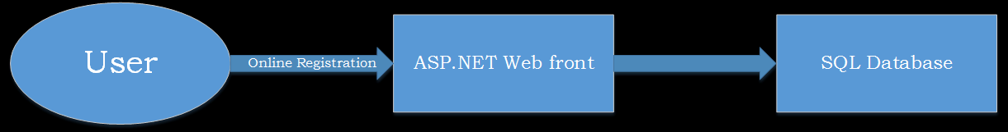
Online Registration
Online Registration is the web-based portion of the software. It contains a form for registration, including fields for team name, spaces for team members, contact information, and email address of the team leader. Once registered, the team information will be added to the database and an email will be sent out with confirmation. Tournament organizers can use the contact information to send emails to team leaders containing important information and changes to the tournament.

Slide 4
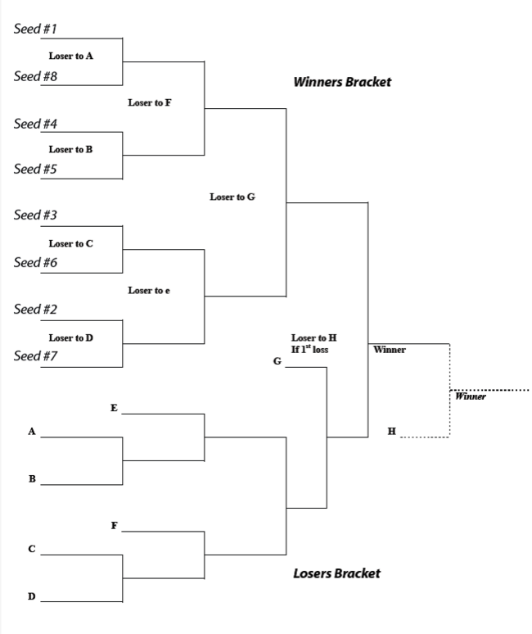
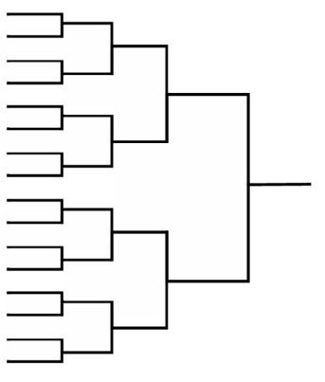
Bracket Manager
Bracket Manager is a local feature which allows the tournament organizer to choose between bracket style and round robin style, with the option for double elimination mode. During the actual tournament, bracket manager will allow the tournament organizer to enter wins and losses, with an optional field for the score. When a match is over, the organizer will enter wins and losses, and the software will move the teams to their appropriate place (e.g. the next level in bracket mode or the next matchup in round robin mode). At any point, the organizer will be able to manually override any decision of the software to resolve any issues.

Slide 5
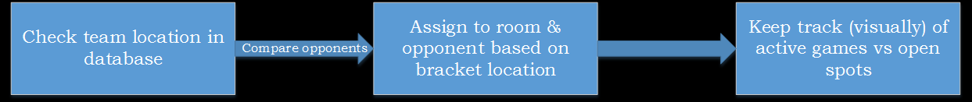
Venue Manager
Venue Manager keeps track of multiple-venue tournaments - when there is more than one playing area or room. This software will work with Bracket Manager to assign rooms to teams depending on their location on the bracket. It will be used to match teams to their opponent with the least amount of venue switching possible. It can be used in Traditional Mode, where teams will face each other in the same venue, or in eSport Mode, where teams facing each other must be in different rooms. Like Bracket Manager, Venue Manager can be operated in manual mode to override decisions of the program.

Slide 6
Timetable, milestones, high-level planning
Tournament management consists of three interdependent modules, all of which can be developed separately up to a point. The first component developed will be the database, which will be the common medium for data between the three components. Once that is completed, the registration, bracket, and venue managers can be developed separately. The registration component only needs to be able to interact with the database, so it requires the least amount of integration testing. The bracket manager and venue manager, while listed here separately, will actually be part of the same executable, so will require extensive integration testing and must be developed together as much as possible. The project can be divided as follows:
Phase 1: Requirements
Phase 2: Design
Phase 3: Database
Code SQL database
Phase 4: Primary coding
Registration
Local program
Registration
Bracket and Venue
Phase 5: Integration
Test registration with database
Test bracket and venue with database
Phase 6: Final Testing
Phase 7: Deployment
Division of work:
Since the registration module and the database are so interconnected, it would be recommended for the same team member to design and code both systems. The bracket and venue require extensive GUI design and non-trivial engine coding, as well as being closely integrated to each other, so the remaining team members should work on both in tandem. In the event that one module is finished before the others, the team member(s) working on that module will be reassigned to the other module(s).

Slide 7
Repository Policy
Using GIT instead of SVN
Comment all commits
Come to agreements as to when major releases are committed

Slide 8
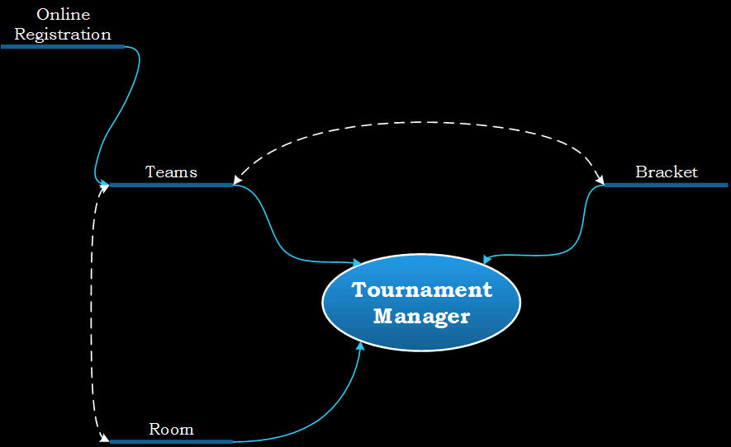

Slide 9
Risk Management
Time Management
Feature Planning
Identifications of Strengths
Project Management
Collaboration

